Slide 1

PBCST504 – MICROCONTROLLERS
MICRO PROJECT
Zeroth Review

Slide 2
Title:- PhantomX – Biometric Continuous Authentication System
Group No: 2
Members:
Abhijith S-JEC24CC001
Adwaith A-JEC24CC008
Indrajith PR-JEC24CC038
Nived Krishna H-JEC24CC047
S Ansaf Shayan-JEC24CC051
Project Coordinator:
Ms.Sagna L T
Asst. Prof. CSE(CY)

Slide 3
DEPARTMENT OF COMPUTER SCIENCE & ENGINEERING
(Cyber Security)
Vision of the Department
To be a globally recognized centre of excellence in Cyber Security education, research and innovation by nurturing ethical professionals , fostering technological advancement through responsible practice and contributing to a secure and sustainable digital society.

Slide 4
DEPARTMENT OF COMPUTER SCIENCE & ENGINEERING
(Cyber Security)
Mission of the Department
M1: Excellence in Education : To provide outcome-based and industry-oriented education by integrating core computer science principles with advanced cybersecurity technologies and practices.
M2: Ethics and Professional Responsibility : To cultivate ethical values, integrity, social responsibility, and secure computing practices for protecting digital assets and strengthening cyber trust.
M3: Research, Innovation, and Entrepreneurship : To promote research, innovation, and entrepreneurial thinking for developing sustainable solutions to emerging cybersecurity challenges.
M4: Holistic and Global Development : To enhance leadership, teamwork, lifelong learning, and global competence through industry collaboration, interdisciplinary activities, and community engagement.

Slide 5
Programme Educational Objectives (PEOs)
PEO 1: Graduates will apply strong foundations in computer science and cybersecurity to design, develop, and manage secure and reliable computing systems for industry and society.
PEO 2: Graduates will pursue successful careers as professionals, innovators or entrepreneurs engaged in technology development, deployment or engineering system implementation in industry and society and contribute to the economic growth of the country.
PEO 3: Graduates will demonstrate ethical responsibility, leadership, teamwork, and effective communication while adapting to evolving global technological environments through lifelong learning.

Slide 6
Programme Outcomes
Engineering Graduates will be able to:
1. Engineering knowledge: Apply the knowledge of mathematics, science, engineering fundamentals, and an engineering specialization to the solution of complex engineering problems.
2. Problem analysis: Identify, formulate, review research literature, and analyze complex engineering problems reaching substantiated conclusions using first principles of mathematics, natural sciences, and engineering sciences.
3. Design/development of solutions: Design solutions for complex engineering problems and design system components or processes that meet the specified needs with appropriate consideration for the public health and safety, and the cultural, societal, and environmental considerations.
4. Conduct investigations of complex problems: Use research-based knowledge and research methods including design of experiments, analysis and interpretation of data, and synthesis of the information to provide valid conclusions.
5. Modern tool usage: Create, select, and apply appropriate techniques, resources, and modern engineering and IT tools including prediction and modeling to complex engineering activities with an understanding of the limitations.

Slide 7
6. The engineer and society: Apply reasoning informed by the contextual knowledge to assess societal, health, safety, legal and cultural issues and the consequent responsibilities relevant to the professional engineering practice.
7. Environment and sustainability: Understand the impact of the professional engineering solutions in societal and environmental contexts, and demonstrate the knowledge of, and need for sustainable development.
8. Ethics: Apply ethical principles and commit to professional ethics and responsibilities and norms of the engineering practice.
9. Individual and team work: Function effectively as an individual, and as a member or leader in diverse teams, and in multidisciplinary settings.
10. Communication: Communicate effectively on complex engineering activities with the engineering community and with society at large, such as, being able to comprehend and write effective reports and design documentation, make effective presentations, and give and receive clear instructions.
11. Project management and finance: Demonstrate knowledge and understanding of the engineering and management principles and apply these to one’s own work, as a member and leader in a team, to manage projects and in multidisciplinary environments. 12. Life-long learning: Recognize the need for, and have the preparation and ability to engage in independent and life-long learning in the broadest context of technological change.

Slide 8
Programme Specific Outcomes (PSOs)
On the completion of Computer Science & Engineering program, the students will possess:
PSO 1: Apply cyber security principles to mitigate cyber risk and analyze security requirements of an organization.
PSO 2: Develop and deploy secure software and infrastructure using modern tools and industry standards.
PSO 3: Uphold ethical, legal, and societal responsibilities while protecting privacy, data, and digital assets.

Slide 9
CONTENTS
Motivation
Introduction
Problem Statement
Proposed Method
Basic Block Diagram
Conclusion
References

Slide 10
Motivation
• Most computers authenticate the user only once, at login.
• An unlocked, unattended workstation lets anyone nearby access sensitive data.
• Enterprises need a system that keeps confirming “is the right person still here?” — continuously, not just once.

Slide 11
Introduction
• PhantomX is an ESP32-based continuous authentication system for enterprise PCs.
• Combines fingerprint biometrics with Bluetooth Low Energy (BLE) proximity sensing.
• Verifies the user once at login, then keeps checking that their device is nearby.
• Automatically locks the PC the moment the user walks away.

Slide 12
Problem Statement
• Login-only authentication leaves the system vulnerable after unlock.
• Anyone nearby can access sensitive data on an unattended, unlocked PC.
• PhantomX fixes this with fingerprint login + continuous BLE presence checks + automatic locking.

Slide 13
Proposed Method
• Login: user opens the PhantomX app and enters username & password.
• Fingerprint verification: ESP32 matches the scan against enrolled templates.
• Desktop unlock: session starts, green LED turns on.
• Continuous authentication: BLE checks ESP32 presence every few seconds.
• Auto-lock: if BLE disconnects, the PC locks, logs the event, red LED turns on.
• All ESP32 ↔ desktop messages use AES-128 encryption with challenge–response verification.

Slide 14
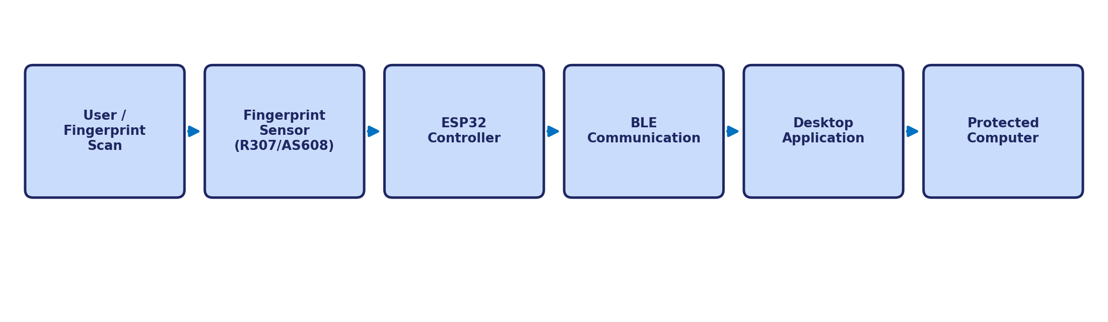
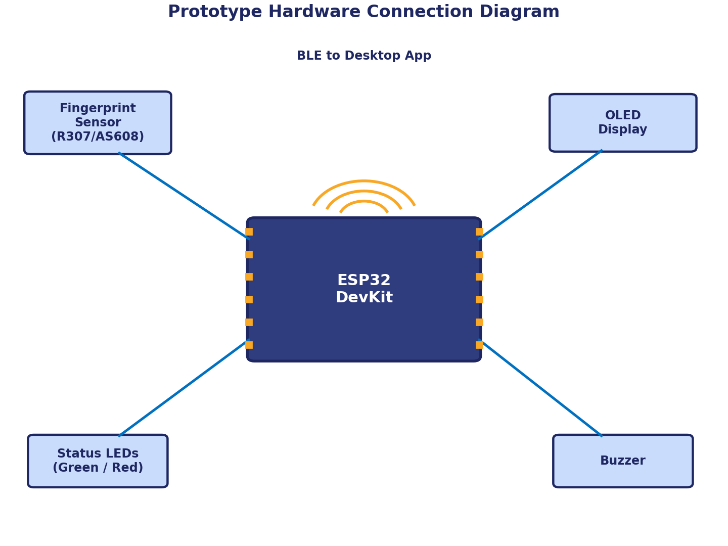
Basic Block Diagram
System Architecture
Prototype Hardware Connection Diagram
• Fingerprint match → ESP32 authenticates → BLE link established with desktop app.
• App polls BLE every few seconds; if the ESP32 goes out of range, the PC locks automatically.

Slide 15
Conclusion
• PhantomX delivers continuous, hands-free authentication instead of a one-time login check.
• Combines fingerprint biometrics, BLE proximity sensing, and AES-128 challenge–response security.
• Automatic locking removes the risk of an unattended, unlocked workstation.
• Low-cost (₹2,800–₹3,300) and scalable to banks, hospitals, labs, and offices.

Slide 16
References
1. Espressif – ESP32 Series Datasheet
2. Adafruit – Optical Fingerprint Sensor Guide
3. Bluetooth SIG – Bluetooth Low Energy Overview
4. NIST – Advanced Encryption Standard (FIPS 197)
5. Wikipedia – Challenge–Response Authentication

